Slide 1


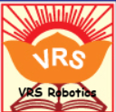

VRS ROBOTICS
The Place Where We Just Not Predict Future We Create The future

Slide 2
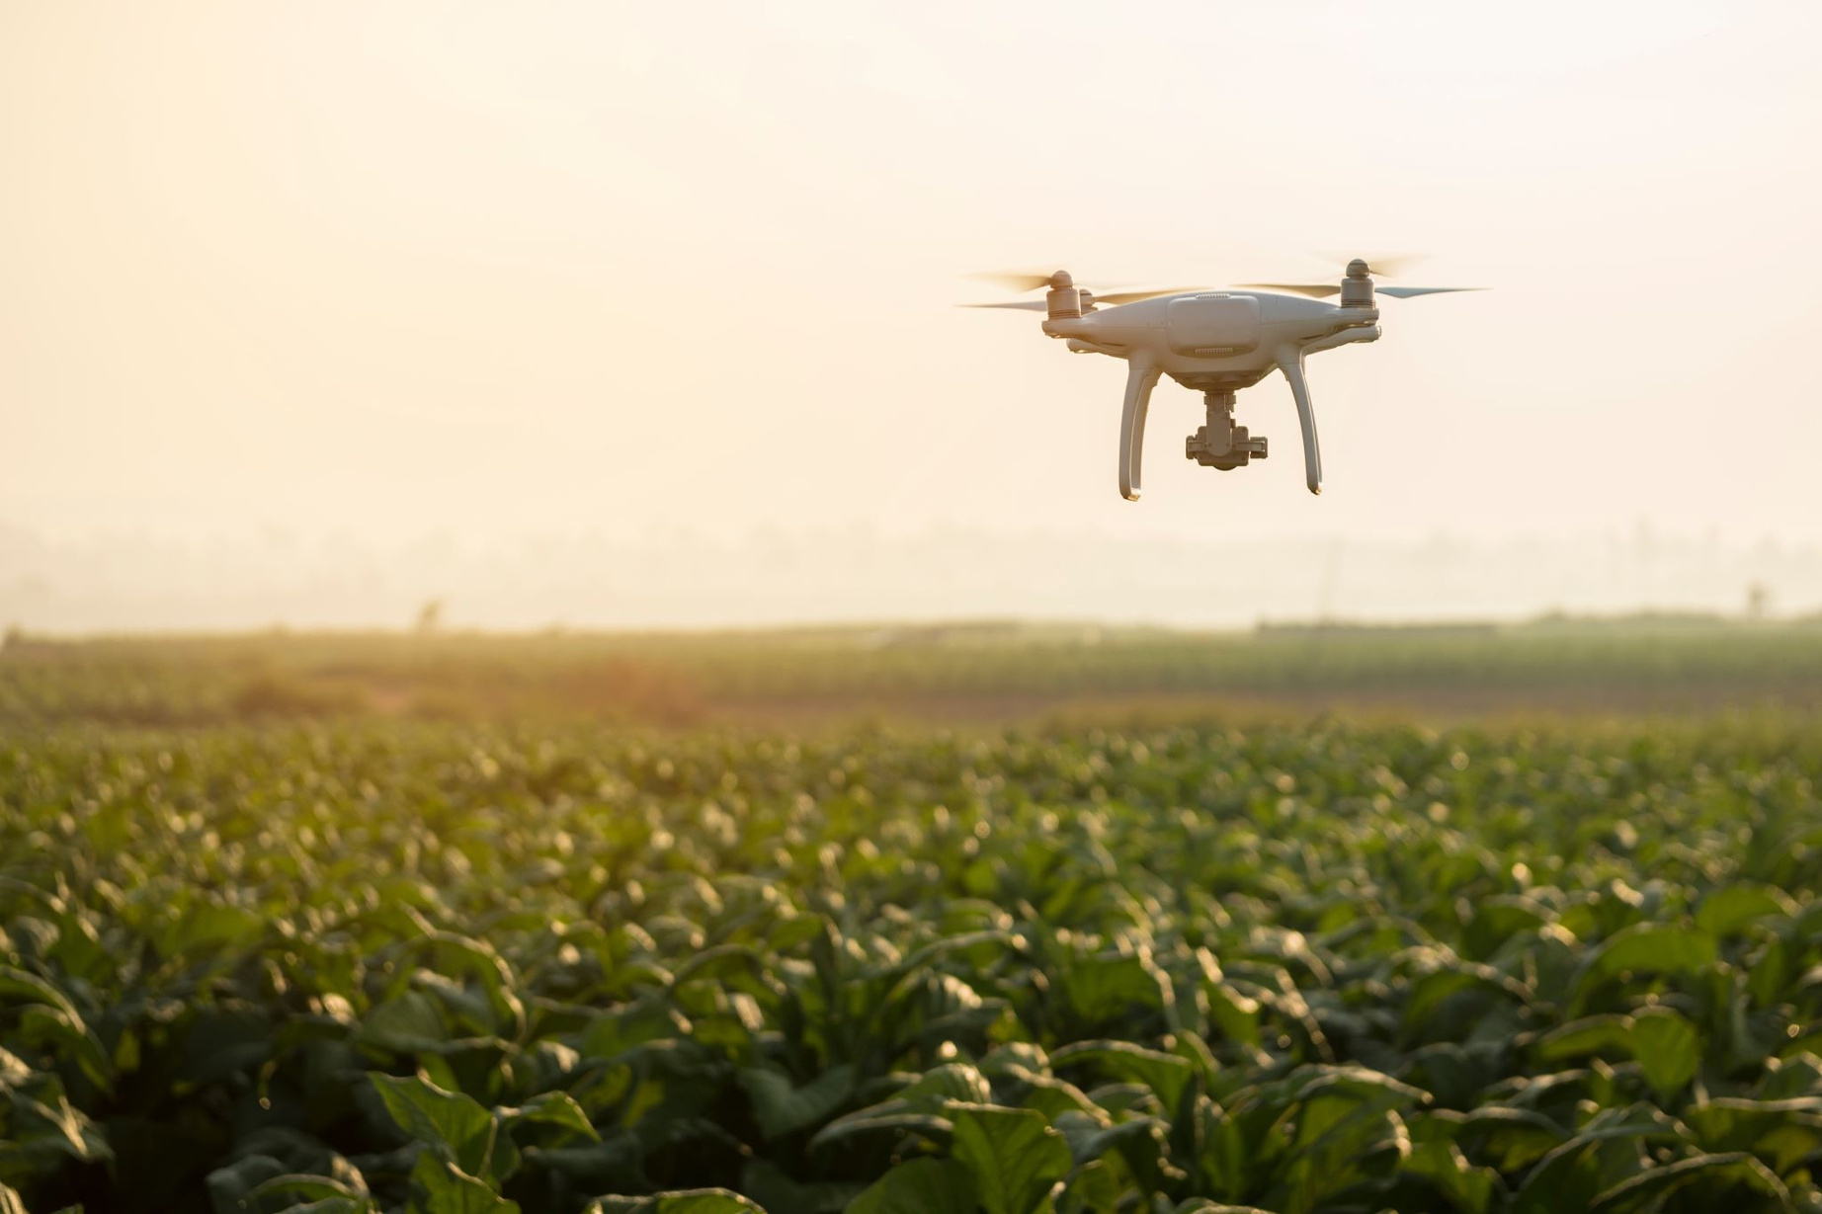

Smart Irrigation System​
Automated Watering with Sensor-Based Control​
by Rebellions

Slide 3

Meet the Rebellions Team
Vishwa (Coding lead)
coded an ESP8266‑based smart irrigation system that uses sensors to monitor and automatically control water flow.
Aarush (Vice-captain)
Bruvan (Captain)
Guiding the vision and ensuring project success.
Providing leadership and strategic direction for the team.
Adeen (Testing & Optimization)
Validated system performance, calibrated sensors, and refined algorithms for real-world conditions.

Slide 4
Table of contents
Table of contents
01.
The Problem with Traditional Irrigation
02.
Circuit Design
Components of Project
03.
04.Description of components
05.
Project Objectives
How It Works: The Logic
06.
Conclusion
07.

Slide 5
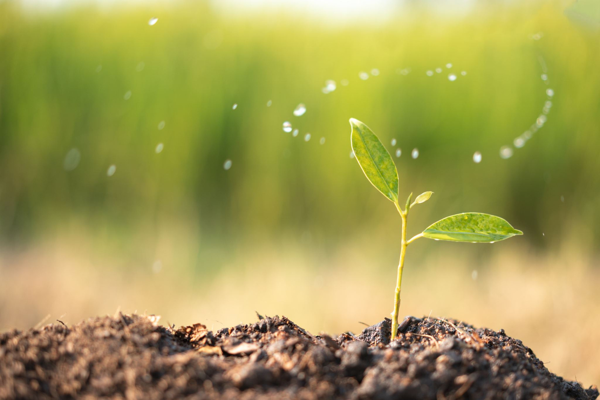
Project Objectives​
Automated Irrigation
Monitor Water Level
Conserve Water

Slide 6
The Problem with Traditional Irrigation
Manual Watering
Highly labor-intensive and inherently inconsistent, often leading to either overwatering or underwatering plants, hindering healthy growth.
Fixed-Schedule Systems
These systems operate blindly, ignoring dynamic weather conditions and actual soil moisture levels, resulting in excessive water waste and potential plant damage.
Significant Water Waste
Up to 50% of water can be lost through evaporation, runoff, and deep percolation in conventional irrigation methods, squandering a precious resource.
No Real-Time Data
Farmers and gardeners lack crucial visibility into precise soil conditions, making it nearly impossible to make informed and timely irrigation decisions.

Slide 7
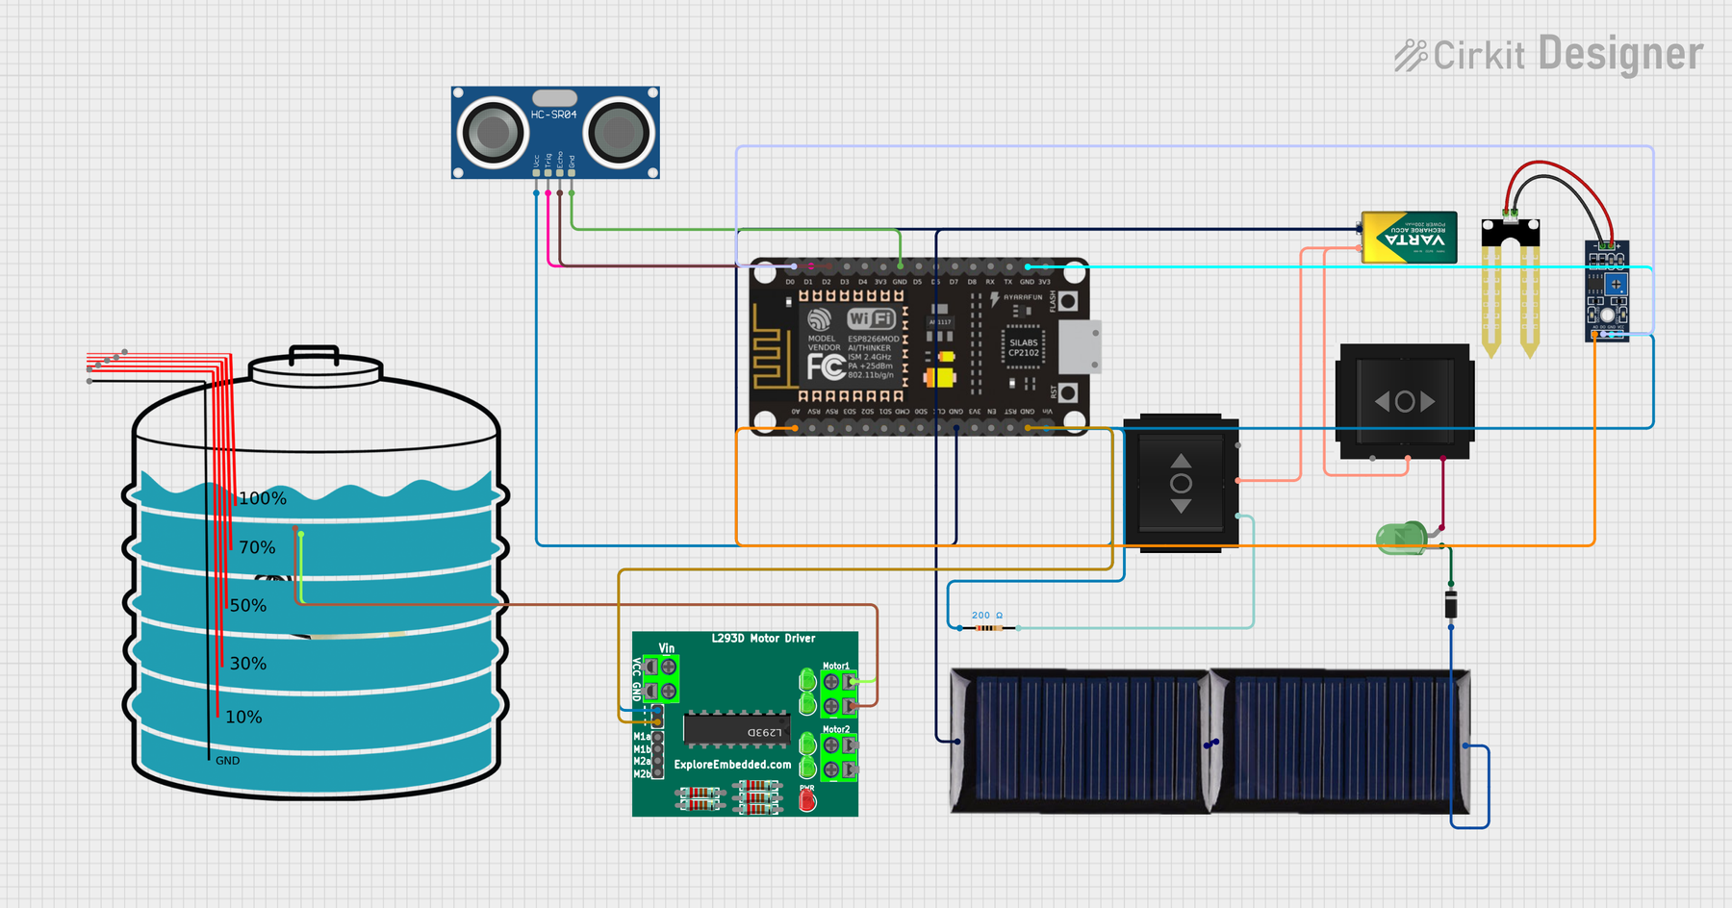

Circuit Design

Slide 8

#define BLYNK_TEMPLATE_ID "TMPL30_VqPiVn"
#define BLYNK_TEMPLATE_NAME "LED"
#define BLYNK_AUTH_TOKEN "s2r1kOj7ZSD94iQRVTilZziFNyYN2y_L"
#include <ESP8266WiFi.h>
#include <BlynkSimpleEsp8266.h>
char auth[] = "s2r1kOj7ZSD94iQRVTilZziFNyYN2y_L";
char ssid[] = "VRSIITJIO4G";
char pass[] = "5234536972";
// ----- PIN DEFINITIONS -----
#define LED_PIN 2 // D4
#define SliderPin 12 // D6
#define trig 5 // D1
#define echo 4 // D2
#define soil A0
long duration;
int distance_;
int maxDistance = 15;
int guage;
BlynkTimer timer;
bool ledState = true;
// ---------------- BUTTON (V0) : LED CONTROL ----------------
BLYNK_WRITE(V0)
{
ledState = param.asInt();
digitalWrite(LED_PIN, ledState);
Serial.println(ledState ? "LED ON" : "LED OFF");
}
// ---------------- SLIDER (V1) : OUTPUT ----------------
BLYNK_WRITE(V1)
{
int v = param.asInt();
digitalWrite(SliderPin, v);
Serial.print("Slider Value = ");
Serial.println(v);
}

Slide 9

Components​
01. ESP8266
02.Soil Moisture Sensor
03.Ultrasonic Sensor
04.Solar Panel
05.water pump
06.Connection

Slide 10
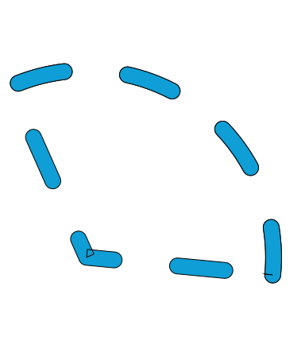
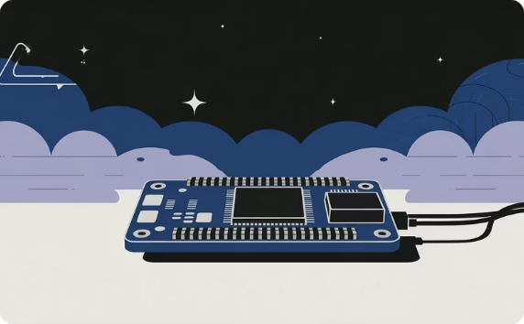

ESP8266
The ESP8266 is a low-cost, highly integrated Wi-Fi microcontroller (MCU) System-on-a-Chip (SoC) from Express if Systems that is widely used for Internet of Things (IoT) applications. It gained popularity in the maker community for its low price and built-in Wi-Fi capability, allowing microcontrollers to connect to wireless networks.

Slide 11

soil moisture
A soil moisture sensor measures the volumetric water content in the soil and is a key tool for optimizing irrigation and plant health. These sensors typically use either resistive or capacitive technology, with the latter being more durable and accurate for long-term use in DIY projects and commercial applications.

Slide 12
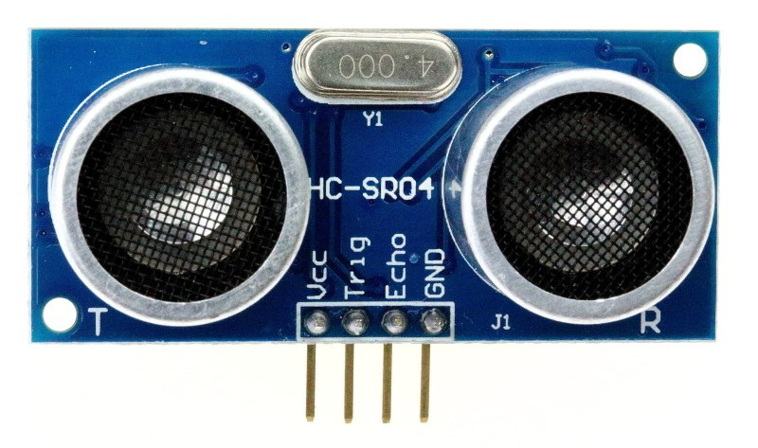
Ultrasonic Sensor
An ultrasonic sensor is a device that measures the distance to an object by emitting ultrasonic sound waves and measuring the time it takes for the echo to return (time-of-flight principle).

Slide 13

Miniature water pumps are essential components in various DIY electronics and robotics projects, ranging from simple science experiments to sophisticated automated systems. They are typically low-cost, DC-powered (3V to 12V), and easily integrated with microcontrollers like Arduino and ESP8266.

Slide 14
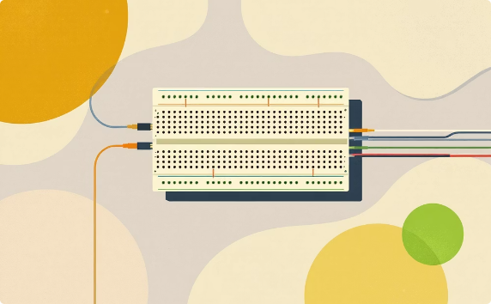
Jumper wires are flexible electrical wires used to connect components to each other or to a development board without needing to solder. They are the standard for prototyping with breadboards, microcontrollers like Arduino or Raspberry Pi, and other electronic components.

Slide 15
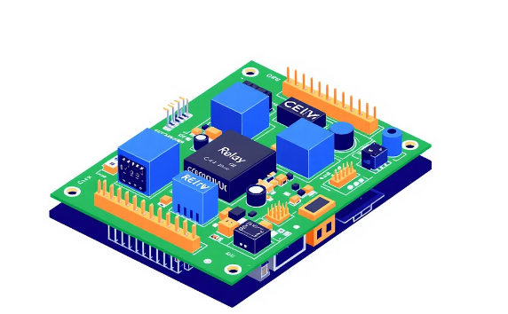
A relay module is an electronic circuit board that enables a low-power control signal, typically from a microcontroller like an Arduino or Raspberry Pi, to safely switch on or off a much higher-power electrical device or circuit. They are widely used in home automation and industrial applications for electrical isolation and load control

Slide 16
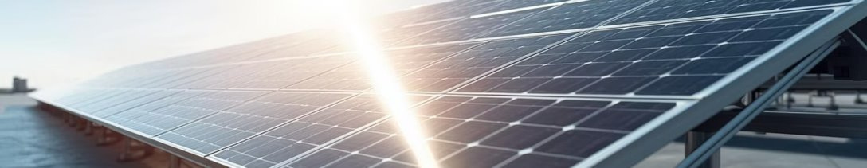

Solar Panel Integration
This integration not only reduces operational costs but also minimizes the environmental footprint of the irrigation system, making it ideal for remote locations or eco-conscious users.

Slide 17

Rainwater Harvesting Integration
A crucial aspect of our sustainable approach is rainwater harvesting. This process involves collecting and storing rainwater from various surfaces, such as rooftops or designated ground areas, for later use in irrigation.

Slide 18

How It Works: The Logic
Our smart irrigation system operates through a continuous feedback loop, ensuring efficient water delivery.
Sensor Reading
The soil moisture sensor continuously monitors soil dampness through analog input, providing real-time data.
Data Processing
The NodeMCU micro-controller compares the sensor reading to a preset moisture threshold (e.g., 50%).
Tank Check
An ultrasonic sensor verifies that the water level in the tank is sufficient before any watering commences.
Pump Activation
If soil moisture is below the threshold AND the tank has enough water, the relay energizes the water pump.
Continuous Monitoring
The system constantly cycles through these checks, automatically shutting off the pump once the soil reaches the target moisture
level.

Slide 19
CONCLUSION
The Rebellions team has successfully developed an innovative smart irrigation system that automates water delivery through precise sensor-based control. This breakthrough ensures significant water conservation, reduces manual effort for farmers, and provides real-time monitoring for optimal crop health.
Our solution champions sustainable farming practices, making a tangible positive impact on environmental preservation. It represents a vital step towards modern agriculture, enhancing both efficiency and ecological responsibility.
We envision a future where intelligent farming technologies, like our smart irrigation system, lead the way in ensuring global food security and promoting ecological balance for generations to come. Join us in cultivating a smarter, more sustainable world.

Slide 20
Thank you

